Slide 1
Videos On The Block
Blockchain-Based Mini-Project

Slide 2
Problem Statement
People need to earn from videos they make.
People watch videos online.
Video streaming subscriptions are expensive.
Viewers pay even when they do not watch anything.
Viewers need to pay for what they’ve watched.
The views history must not be tempered with.
There’s a need for decentralized system for sharing videos.
Need to be secure.

Slide 3
Solution
A Desktop App for sharing videos.
The App is based on Peer-Peer networking.
All users must be able to upload videos.
The video watch transactions are stored on a blockchain.
Block is created by the viewer and validated by the owner.
Every video watch is encrypted with a private and public keys.

Slide 4
Peer-Peer Communication Commands
HELO – Initiating communication
HELO CLIENT – Response to HELO, Confirms connection.
REQUEST CLIENT – Request client to send an instance of their Client class.
RECEIVE CLIENT – Readies client to receive Client object.
BLOCK RECEIVE – Readies client to receive Block object.
BLOCK VALIDATE – Readies client to receive Block and to validate it.
BLOCK RECEIVE VALIDATED – Readies client to receive validated Block.

Slide 5
Peer-Peer Communication Commands
BLOCKCHAIN RECEIVE – Readies client to receive a copy of the Blockchain
BLOCKCHAIN REQUEST – Readies client to send a copy of the Blockchain.
GRAPH RECEIVE – Readies client to receive a copy of the Graph.
GRAPH REQUEST – Readies client to send a copy of the Graph.

Slide 6
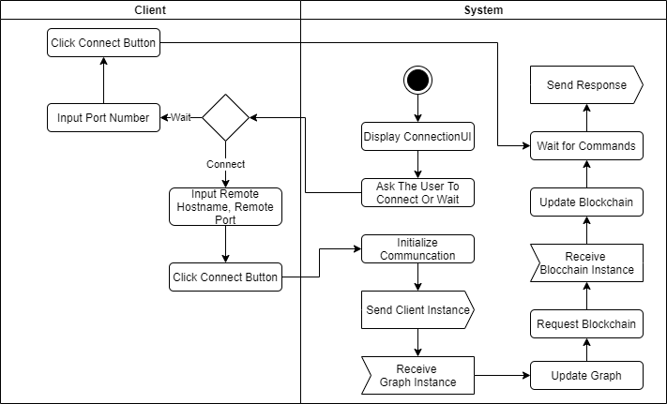
Desktop App On start Activity-Flow

Slide 7
The Jar File
Require JavaFx modules
javafx.controls
javafx.graphics
javafx.media

